Slide 1
Typescript/C# Class Definitions
Backend\AppCommon\Models\EndPointModels.cs
The authoritative source for typescript class definitions is in AltSpire/client/src/app/universal/app.types.ts
This gets REPLICATED to altspire/server/universal/app.types.ts by running altspire/client$ gulp
In ConsumerUI, the types necessary for the consumerui, use (a subset of altspire app.types.ts) are HAND-COPY/PASTED to Consumerui/src/app/universal/app.types.ts.
For SpirePlus – the same class names and property names will be ported and maintained in SpirePlus/
AltSpire
Copy/paste necessary types to
Client/src/app/universal/app.types.ts
ConsumerUI
src/app/universal/app.types.ts
Replicated
Client$ gulp
Port and keep sync’d up necessary types to
server/src/universal/app.types.ts
C# Spire Plus - Backend
Backend\AppCommon\Models\EndPointModels.cs
Watch out, if you update types in server first/only, sooner or later it’s going to get rolled over.

Slide 2
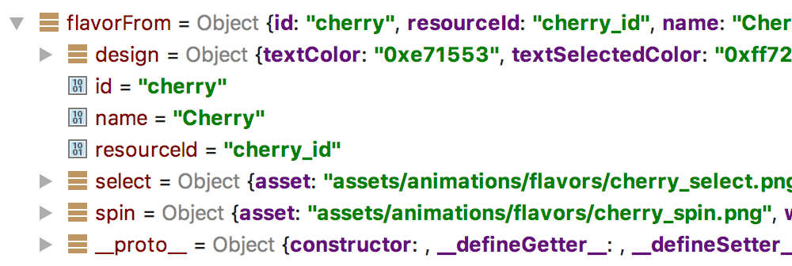
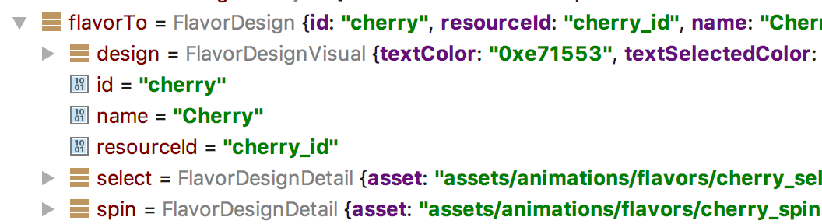
Typescript – Object Mapping
Object coming in across the wire or has been stringified.
Objects will be missing typescript functions. I.e. Getters/Setters.
Note everything is of Object type.
Fix incoming object by using JsUtil.mapToNewObject. On the top level object and encapsulated objects too.
This will copy the incoming values to an object that is provided as the second argument.
For this to work, all properties on class definitions must provide a default value.
let flavorTo = new FlavorDesign(); flavorTo = JsUtil.mapToNewObject(flavorFrom, flavorTo) ; flavorTo.design = JsUtil.mapToNewObject(flavorFrom.design, new FlavorDesignVisual()); flavorTo.select = JsUtil.mapToNewObject(flavorFrom.select, new FlavorDesignDetail()); flavorTo.spin = JsUtil.mapToNewObject(flavorFrom.spin, new FlavorDesignDetail());
Now object and subtypes has type definitions.
Functions defined on the typescript class are now available.

